Slide 1
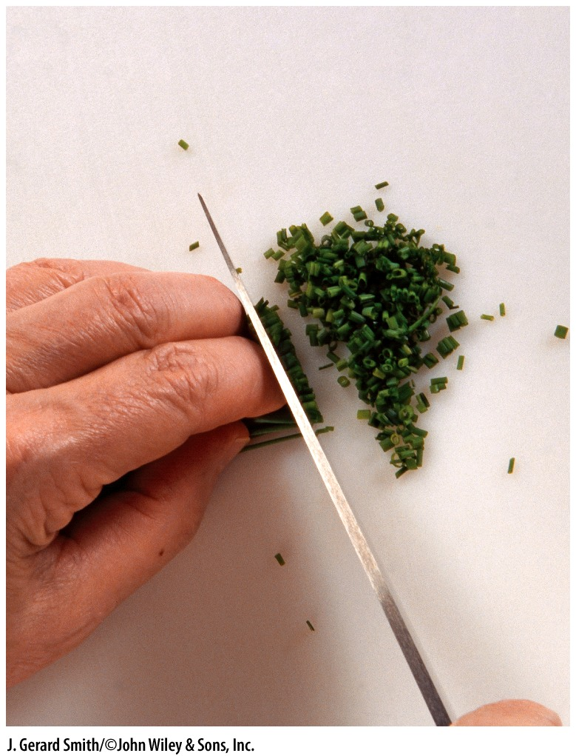
Sanitation and Safety
Chapter 2
Safety and Sanitation

Slide 2
Sanitation
Professionalism: An attitude that reflects pride in the quality of your work. One of the most important ways of demonstrating professional pride is in the area of sanitation and safety.
Poor sanitation and safety can cost a lot of money.
The rules presented in this chapter are basic guidelines.
Local health departments have more detailed regulations.
All food-service operators are responsible for knowing the health department regulations in their own city and state.
Safety and Sanitation
Notes:
1.Pride in quality is reflected in your appearance and work habits.
Poor hygiene, poor grooming and personal care, and sloppy work habits are unacceptable.
2. Poor food-handling procedures and unclean kitchens cause illness, unhappy customers and even fines, summons, and lawsuits.
Food spoilage raises food costs.
Poor kitchen safety results in injuries, medical bills, and lost workdays.
Poor sanitation and safety habits show lack of respect for your customers, for your fellow workers, and for yourself

Slide 3
Food Hazards
Key Points
Most food-borne illness is the result of eating food that has been contaminated.
Contaminated means the food contains harmful substances not originally present in it.
Contaminated food is food that is not pure.
Safety and Sanitation

Slide 4
Food Hazards
Key Points (cont’d)
Any substance in food that can cause illness or injury is called a hazard.
Four types of food hazards:
Biological hazards
Chemical hazards
Physical hazards
Allergens
Safety and Sanitation

Slide 5
Food Hazards
Key Points (cont’d)
Some illnesses are caused by substances that occur naturally in foods, such as:
Plant toxins (or “poison”), such as the chemicals in poisonous mushrooms.
Natural food components to which some people are allergic.
Safety and Sanitation

Slide 6
Food Hazards
PATHOGENS
Microorganism: a tiny, usually single-celled organism that can be seen only through a microscope.
Pathogen: A microorganism that can cause disease.
Four kinds of microorganisms can contaminate food and cause illness:
Bacteria
Viruses
Fungi
Parasites
Safety and Sanitation

Slide 7
Food Hazards
Pathogens (cont’d)
Bacteria
Bacteria are in the air, in the water, in the ground, on our food, on our skin, and inside our bodies.
As food workers, we are interested in a way of classifying bacteria that is practical to our work:
Harmless bacteria
Beneficial bacteria
Undesirable bacteria
Disease-causing bacteria, or pathogens
Safety and Sanitation

Slide 8
Food Hazards
Pathogens (cont’d)
Bacterial Pathogens
Pathogens do not necessarily leave detectable odors or tastes in food.
Contaminated food cannot be detected by smell, taste, or look alone.
Safety and Sanitation

Slide 9
Food Hazards
Pathogens (cont’d)
Bacterial Pathogens (cont’d)
Each kind of bacterial pathogen causes disease in one of three ways:
Intoxications: caused by poisons (toxins) the bacteria produce while they are growing in the food.
Infections: caused by bacteria (or other organisms) that get into the intestinal system and attack the body.
Toxin-mediated infections: caused by poisons the bacteria produce as they grow and multiply in the body.
Most food-borne diseases are toxin-mediated infections.
Safety and Sanitation

Slide 10
Food Hazards
Pathogens (cont’d)
Bacterial Growth Conditions:
Food: foods with sufficient amounts of proteins are best for bacterial growth.
Moisture: bacteria require water to absorb food.
Temperature: 40ºF to 140ºF (4ºC to 60ºC), promote the growth of disease-causing bacteria (also known as the Food Danger Zone).
Acidity or alkalinity: bacteria like neutral environments, neither too acidic nor too alkaline.
Oxygen: aerobic (bacteria that require oxygen to grow) and anaerobic (bacteria that can grow only if there is no air present).
Time: lag phase (time required for bacteria to adjust to new environment).
Safety and Sanitation

Slide 11
Food Hazards
Pathogens (cont’d)
Potentially Hazardous Foods (TCS Foods)
Foods that provide a good environment for the growth of disease-causing microorganisms
These foods are also called TCS foods—the abbreviation stands for Time/Temperature Control for Safety.
Safety and Sanitation

Slide 12
Food Hazards
Pathogens (cont’d)
Potentially Hazardous Foods (TCS Foods) (cont’d)
All of these foods, plus any foods prepared with any of them, are potentially hazardous:
Any food derived from animals, or any food containing animal products
Any food derived from plants that has been cooked, partially cooked, or otherwise heat-treated.
Raw seed sprouts.
Sliced melons
Cut tomatoes
Garlic and oil mixtures
Safety and Sanitation

Slide 13
Food Hazards
Pathogens (cont’d)
Locomotion of Bacteria
Foods can become contaminated by any of the following means:
Hands
Air
Coughs and sneezes
Water
Other foods Insects
Equipment and utensils
Rats and mice
Safety and Sanitation

Slide 14
Food Hazards
Pathogens (cont’d)
Protecting Against Bacteria
Keep bacteria from spreading.
Stop bacteria from growing.
Kill bacteria.
Safety and Sanitation

Slide 15
Food Hazards
Pathogens (cont’d)
Viruses
Smaller than bacteria.
Cannot reproduce or multiply unless they are inside a living cell.
Can be carried on almost any surface and can survive for days or even months.
Inactive or dormant until they enter a living cell.
Use living cells to make more viruses and release them into the organism.
New viruses enter new cells and continue to multiply.
Food-borne viral diseases are usually caused by contamination from people, food contact surfaces, or contaminated water.
Safety and Sanitation

Slide 16
Food Hazards
Pathogens (cont’d)
Parasites
Organisms that can survive only by living on or inside another organism.
Host: The organism a parasite lives in and takes nourishment from.
May pass from one host organism to another and complete a different stage of their life cycle in each organism.
Human parasites are generally transmitted to them from animal hosts.
Human parasites are usually very small, and although they may be microscopic, they are larger than bacteria.
Usually killed by proper cooking or by freezing.
Safety and Sanitation

Slide 17
Food Hazards
Pathogens (cont’d)
Fungi
Molds and yeasts are examples of fungi.
Organisms associated primarily with food spoilage rather than food-borne disease.
Most molds and yeasts, even those that cause spoilage, are not dangerous to most human beings.
Some fungi are beneficial.
Some molds, however, produce toxins that can cause allergic reactions and severe disease.
Certain molds produce a toxin called aflatoxin in such foods as peanuts and other nuts, corn, cottonseed and milk. This toxin can cause serious liver disease in some people.
Safety and Sanitation

Slide 18
Food Hazards
Pathogens (cont’d)
Other Biological Hazards
Plant Toxins
Some plants are naturally poisonous to human beings.
The only way to avoid plant toxins is to avoid the plants in which they occur, as well as products made with those plants.
Can be transferred in milk from cows that have eaten the plant (e.g., jimsonweed and snakeroot) or in honey from bees that have gathered nectar from plants (e.g., mountain laurel).
Best-known plant toxins are found in some wild mushrooms.
Other toxic plants to avoid are rhubarb leaves, water hemlock, apricot kernels and nightshade.
Safety and Sanitation

Slide 19
Food Hazards
Pathogens (cont’d)
Other Biological Hazards (cont’d)
Seafood Toxins
Some toxins occur in fish or shellfish that have eaten a kind of algae that contains the toxins.
Not destroyed by cooking.
Only protection is to purchase fish/shellfish from approved suppliers who can certify the seafood comes from safe water.
The fish toxin present in puffer fish attacks the nervous system and can be fatal.
Other species of fish, such as moray eels, contain natural toxins and should be avoided.
Safety and Sanitation

Slide 20
Food Hazards
Prions
Prion diseases comprise several conditions. A prion is a type of protein that can trigger normal proteins in the brain to fold abnormally. Prion diseases can affect both humans and animals and are sometimes spread to humans by infected meat products. The most common form of prion disease that affects humans is Creutzfeldt-Jakob disease (CJD).
Safety and Sanitation

Slide 21
Food Hazards
Pathogens (cont’d)
Some kinds of chemical poisoning are caused by the use of defective, improper equipment, or equipment that has been handled improperly.
The toxins in the following slide create symptoms that show themselves very quickly, usually within 30 minutes of eating poisoned food.
Exception: lead; symptoms of lead poisoning can take years to appear.
Safety and Sanitation

Slide 22
Food Hazards
CHEMICAL AND PHYSICAL HAZARDS
To prevent the following diseases, do not use the materials that cause them:
Antimony: caused by storing or cooking acid foods in chipped gray enamelware
Cadmium: caused by cadmium-plated ice cube trays or containers
Cyanide: caused by silver polish containing cyanide
Safety and Sanitation

Slide 23
Food Hazards
Chemical and Physical Hazards (cont’d)
To prevent the following diseases, do not use the materials that cause them (cont’d):
Lead: caused by lead water pipes, solder containing lead, or utensils containing lead
Copper: caused by unclean or corroded copper utensils, acid foods cooked in unlined copper utensils, or carbonated beverages in contact with copper tubing
Zinc: caused by cooking foods in zinc-plated (galvanized) utensils
Safety and Sanitation

Slide 24
Food Hazards
Chemical and Physical Hazards (cont’d)
Physical contamination: contamination of food with objects that may not be toxic but may cause injury or discomfort:
Pieces of glass from a broken container
Metal shavings from an improperly opened can
Stones from poorly sorted dried beans
Soil from poorly washed vegetables
Insects or insect parts
Hair
Proper food handling necessary to avoid physical contamination.
Safety and Sanitation

Slide 25
Food Hazards
Allergens
Substance that causes an allergic reaction. Reactions to food may occur as soon as the food is eaten or, in some cases, touched; they also may not occur until hours after the food is eaten.
Common symptoms of allergic reaction to foods include:
Itching
Rash or hives
Shortness of breath
Tightness in the throat
Swelling of the eyes and face
Some allergic reactions may lead to unconsciousness or death.
Safety and Sanitation

Slide 26
Food Hazards
Allergens (cont’d)
Allergens affect only some people; these people are said to be allergic to that specific substance.
Foods to which some people are allergic include:
Wheat products
Soy products
Peanuts and tree nuts
Eggs
Milk and dairy products
Fish and shellfish
Safety and Sanitation

Slide 27
Food Hazards
Allergens (cont’d)
Nonbiological allergens include food additives such as:
Nitrites (used in cured meats)
Monosodium Glutamate (MSG, often used in Asian foods)
Safety and Sanitation

Slide 28
Food Hazards
Allergens (cont’d)
Food-service personnel and dining room staff must be well informed of the ingredients in all menu items and be able to inform customers as needed
If any staff member does not know, when asked by a customer, if a food contains an allergen, the employee should:
Consult someone who does know
Urge the customer to order a different item
Safety and Sanitation

Slide 29
Personal Hygiene
Cross contamination: The transference of hazardous substances, mainly microorganisms, to a food from another food or surface
e.g.: equipment, worktables, or hands
Safety and Sanitation

Slide 30
Personal Hygiene
Best Practices
Reflects pride, professionalism, and consideration for your fellow workers:
Do not work if you have any communicable diseases or infections.
Bathe or shower daily.
Wear clean uniforms.
Keep hair clean and use hair restraints.
Keep facial hair trimmed.
Wash your hands often.
Safety and Sanitation

Slide 31
Personal Hygiene
Best Practices (cont’d)
Reflects pride, professionalism, and consideration for your fellow workers (cont’d):
Cover coughs and sneezes, then wash your hands.
Do not touch your body.
Keep fingernails clean and short. Do not wear nail polish.
Do not smoke or chew gum while on duty.
Cover cuts and sores with clean bandages.
Do not sit on worktables.
Wear gloves.
Safety and Sanitation

Slide 32
Food Storage
Rules of Safe Storage
Two purposes:
To prevent contamination of foods
To prevent growth of bacteria that may already be in foods
Perishable foods must be kept out of the Food Danger Zone, 40ºF to 140ºF (4ºC to 60ºC), as much as possible because these temperatures support bacterial growth.
Four-hour rule: Do not let food remain in the Food Danger Zone for a cumulative total of more than four hours between receiving and serving.
Safety and Sanitation

Slide 33
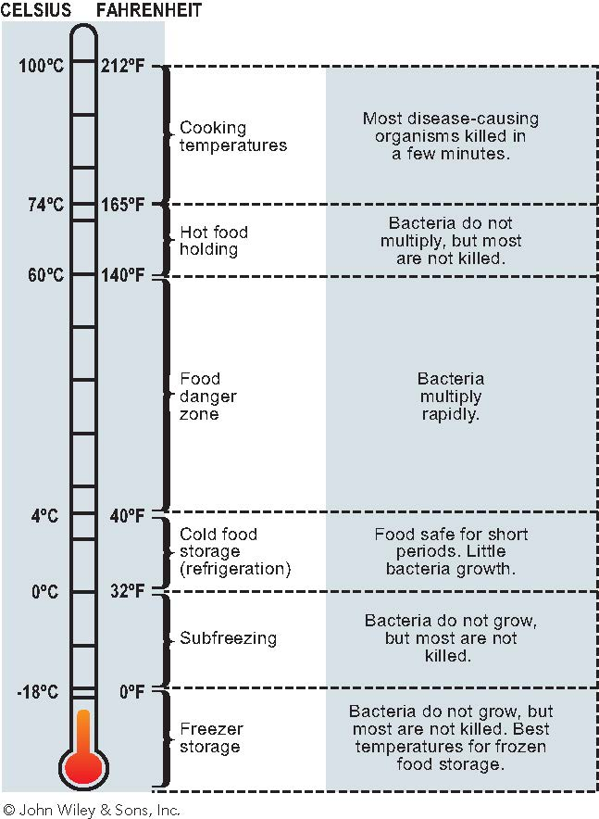
Food Storage
RULES OF SAFE STORAGE

Slide 34
Food Storage
Receiving (cont’d)
Safe food handling begins the moment food is delivered.
Inspect all products thoroughly.
Reject deliveries that do not meet your standards.
Label and date all foods.
Store immediately.
Safety and Sanitation

Slide 35
Food Storage
Dry Food Storage
Store dry foods in a cool, dry place off of the floor, away from the wall, and not under a sewer line.
Keep all containers tightly closed to protect from insects, rodents, and dust. Dry foods can be contaminated, even if they do not need refrigeration
Safety and Sanitation

Slide 36
Food Storage
Freezer Storage and Proper Thawing
Storage
Keep frozen foods at 0ºF (–18ºC) or lower.
Keep all frozen foods tightly wrapped or packaged to prevent freezer burn.
Label and date all items.
Thaw frozen foods properly. Do not thaw at room temperature, because the surface temperature will go above 40ºF (4ºC) before the inside is thawed, resulting in bacterial growth.
Safety and Sanitation

Slide 37
Food Storage
Freezer Storage and Proper Thawing (cont’d)
Thawing: these methods may be used:
In a refrigerator
Under cold running water
In a microwave oven, but only if the item is to be cooked or served immediately
Safety and Sanitation

Slide 38
Food Storage
Refrigerator Storage
Keep all perishable foods properly refrigerated. Note the lower limit of the Food Danger Zone (40ºF / 4ºC) is only the upper limit for refrigerator storage. Most foods keep even better at lower temperatures.
Do not crowd refrigerators. Leave space between items so cold air can circulate.
Keep refrigerator doors shut except when removing or putting in foods.
Keep shelves and interiors of refrigerators clean.
Store raw and cooked items separately, if possible.
Safety and Sanitation

Slide 39
Food Storage
Refrigerator Storage (cont’d)
If raw and cooked foods must be kept in the same refrigerator, keep cooked foods above raw foods. This prevents contamination by means of drips and spills.
7. Keep foods wrapped/covered in sanitary containers.
Do not let unsanitary surfaces touch any food.
9. Chill foods as quickly as possible over ice or in a cold-water bath before placing in the refrigerator.
10. When serving, do not heap foods such as protein salads above container level in a cold bain-marie or refrigerated table. The food above this level will not stay cold enough.
Safety and Sanitation

Slide 40
Food Storage
Hot Food Holding
To keep foods hot for service, use steam tables or other equipment that will keep all parts of all foods above 140ºF (60ºC) at all times.
Keep foods covered.
Bring foods to holding temperature as quickly as possible by using ovens, steamers, rangetop pots and pans, or other cooking equipment. Do not warm cold foods by placing them directly in the steam table; they will take too long to heat and bacteria will have time to grow.
Do not let ready-to-eat foods come in contact with any contaminated surface.
Safety and Sanitation

Slide 41
Food Handling and Preparation
Minimum Internal Cooking Temperature
The internal temperature for a given food product at which microorganisms are killed:
The product must be held at that temperature for a specified period for the food to be considered safe. See Table 2.2.
Be sure to measure internal temperatures in at least two or three places, always inserting the thermometer into the thickest part of the food.
Use sanitary thermometers that are accurate!
Safety and Sanitation

Slide 42
Food Handling and Preparation
Cooling Procedures
Two-Stage Cooling Method
Cool foods from 140ºF (60ºC) to 70ºF (21ºC) in no more than 2 hours, and then from 70ºF (21ºC) to below 40ºF (4ºC) within an additional 4 hours, for a total cooling time of no more than 6 hours.
Safety and Sanitation

Slide 43
Food Handling and Preparation
Cooling Procedures (cont’d)
One-Stage Cooling Method
Cool foods to below 40ºF (4ºC) in no more than 4 hours.
If the food does not reach this temperature in 4 hours it must be reheated to 165ºF (74ºC) and held at that temperature for at least 15 seconds and then cooled again.
The one stage method should be used if the item was made from potentially hazardous foods that were at room temperature when preparation began.
Safety and Sanitation

Slide 44
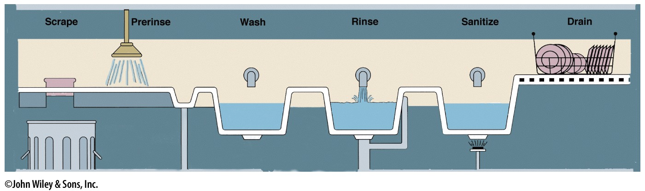
Cleaning and Sanitizing Equipment
Manual Dishwashing
Scrape and rinse
Wash
Rinse
Sanitize
Drain and air dry
Safety and Sanitation

Slide 45
Cleaning and Sanitizing Equipment
Mechanical Dishwashing
The Process
Scrape and rinse
Rack dishes
Run for full cycle
Sanitize
Heat units 180ºF (82ºC)
Chemical units 120ºF (49ºC)
Air dry and inspect
Safety and Sanitation

Slide 46
Rodent and Insect Control
Key Points
Rats, mice, flies, and cockroaches can spread disease to food and contact surfaces.
The four basic ways to prevent them are:
Build them out
Eliminate harborage and breeding places
Eliminate their food supply
Exterminate
Safety and Sanitation

Slide 47
Setting up a System for Food Safety
THE HACCP SYSTEM
The purpose of HACCP is to identify, monitor, and control dangers of food contamination. It is a system of seven steps:
Assess hazards.
Identify critical control points (CCPs).
Set up standards or limits for CCPs.
Set up procedures for monitoring CCPs.
Establish corrective actions.
Set up a recordkeeping system.
Verify the system is working.
Safety and Sanitation

Slide 48
Setting up a System for Food Safety
The HACCP System (cont’d)
Beginning Concept: The Flow of Food
Refers to the movement of food through a food-service operation—from receiving to storage, preparation, and service, until it gets to the final consumer:
Receiving raw ingredients
Storing raw ingredients
Preparing ingredients
Cooking
Holding and serving
Cooling and storing leftovers
Reheating, holding, and storing leftovers
Safety and Sanitation

Slide 49
Setting up a System for Food Safety
The HACCP System (cont’d)
Assessing Hazards: process of identifying which of the following dangerous conditions can occur every step of the process. These hazards can be divided into three categories:
Contamination: such as cross-contamination from a soiled cutting surface, torn packaging that permits insect infestation, working on food without washing hands, and spilling cleaning chemicals on food
Growth of bacteria and other pathogens: due to conditions as inadequate refrigeration or storage and holding hot foods below 135ºF (57ºC).
Survival of pathogens or the continued presence of toxins, usually because of inadequate cooking or heating or inadequate sanitizing of equipment and surfaces.

Slide 50
Setting up a System for Food Safety
The HACCP System (cont’d)
Identifying Critical Control Points
Critical Control Points: stages at which a worker can control the hazards
For any given hazard there may be several control points, or several chances to control the hazard.
The last control point at which a worker can control a particular hazard is especially important to determine because this is the last chance to prevent a possible danger.
These control points are called critical control points (CCPs).
Safety and Sanitation

Slide 51
Safety
The Safe Workplace
The safe workplace is one that monitors:
Preventing cuts
Preventing burns
Preventing and dealing with fires
Preventing injuries from machines and equipment
Preventing falls
Preventing strains and injuries from lifting
Safety and Sanitation

